Slide 1
MISRA C++: 2008 Metrics on Red Ball
Updated December 23, 2014

Slide 2
PC-lint Data
PC-lint was run against the latest promoted code as of 12/23/2014 10:30 AM CST.
No .lnt files were changed since last metrics collection

Slide 3
PC-lint Results (DCI_Data.cpp counted separate, totaled over projects)
 | Violations | Delta
BCM | 0 | -13
MM | 0 | 0
BUI | 0 | -22
PROFI | 0 | 0
ETH | 0 | 0
DCI_Data.cpp | 18 | 0
Babelfish | 0 | 0
Total | 18 | -35
Notes:
Overall Redball

Slide 4
BCM Breakdown by Violation
MISRA Compliant

Slide 5
BCM Breakdown by File (except DCI_Data.cpp)
MISRA Compliant

Slide 6
BCM Violations Over the Last 5 Weeks

Slide 7
MM Breakdown by Violation
MISRA Compliant

Slide 8
MM Breakdown by File (except DCI_Data.cpp)
MISRA Compliant

Slide 9
MM Violations Over the Last 5 Weeks

Slide 10
PROFI Breakdown by Violation
MISRA Compliant

Slide 11
PROFI Breakdown by File (except DCI_Data.cpp)
MISRA Compliant

Slide 12
PROFI Violations Over the Last 5 Weeks

Slide 13
ETH Breakdown by Violation
MISRA Compliant

Slide 14
ETH Breakdown by File (except DCI_Data.cpp)
MISRA Compliant

Slide 15
ETH Violations Over the Last 5 Weeks

Slide 16
BUI Breakdown by Violation
MISRA Compliant

Slide 17
BUI Breakdown by File (except DCI_Data.cpp)
MISRA Compliant

Slide 18
BUI Violations Over the Last 5 Weeks

Slide 19
DCI_Data.cpp Project Breakdown (DCI_Data.cpp counted separate, totaled over projects)
Project | MISRA Errors
BCM | 0
MM | 0
BUI | 0
PROFI | 3
ETH | 15
Notes:
Overall Redball

Slide 20
Babelfish Breakdown by Violation
MISRA Compliant

Slide 21
Babelfish Breakdown by File
MISRA Compliant

Slide 22
Babelfish Violations Over the Last 5 Weeks

Slide 23
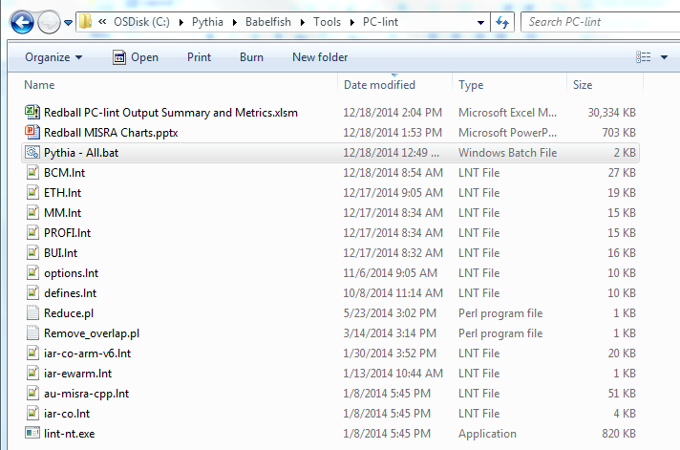
How To Run PC-lint on Redball
Located at \Pythia\Babelfish\Tools\PC-lint, run “Pythia - All.bat” and wait for it to complete.

Slide 24
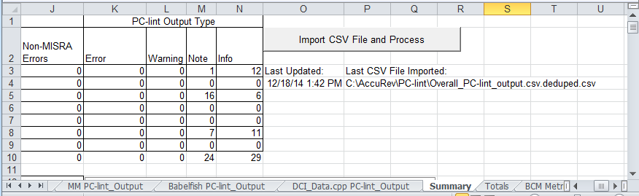
How to Generate Metrics
After running the PC-lint batch file, click the “Import CSV File and Process” button on the Summary tab of the “Redball PC-lint Output Summary and Metrics.xlsm” spreadsheet located in the same folder as the batch file.

Slide 25
How to Maintain Lint Files
Each project has its own .lnt file that contains options, include directories, and a list of files to compile
If a file is added or removed from a project, the .lnt file for that project must be updated.
Example of an include:
-i"C:\Pythia\Babelfish\Code\"
Example of file listings:
"C:\Pythia\Babelfish\Code\BF\DCI\DCI.cpp"

Slide 26


